Slide 1
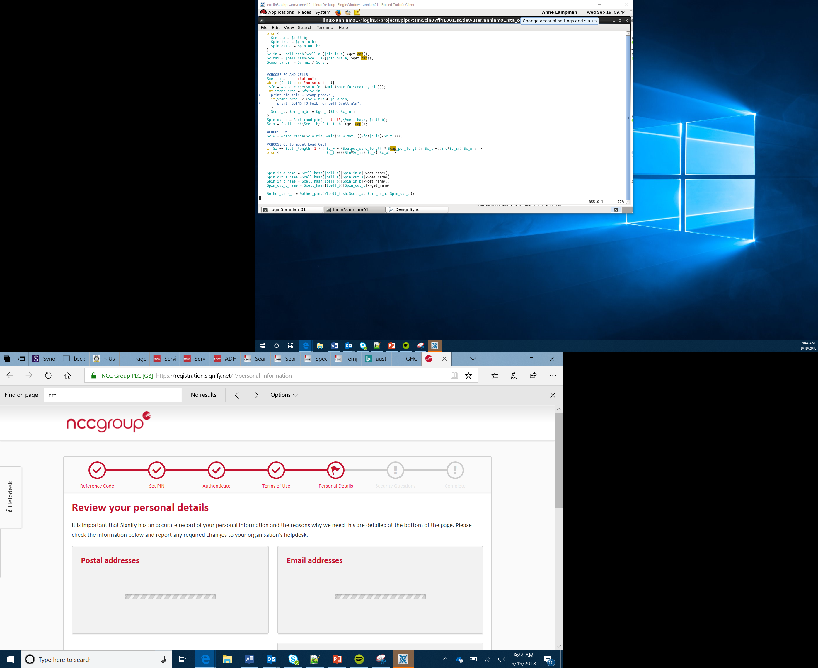

IoT Project
Lesson 23-24

Slide 2
Lesson 11

Slide 3

IoT project
2 lessons
Groups of 4

Slide 4
What you will produce:
A design for a micro:bit based product
A Global Goal themed product using a micro:bit
A logo and branding for your product
An ‘elevator pitch’ for your product (< 2 mins)

Slide 5
The four team roles
Project Manager:
Tasks being completed on time
Checking everything is complete
Storing the product and designs safely
Engineer:
Designing the product
Making the product
Testing the product
Developer:
Designing the IPO process
Programming the micro:bit
Testing the program
Marketing and communications:
Ensuring the team communicate
Creating the logo and branding the product
Writing the elevator pitch

Slide 6
Working in parallel
Project Manager
Engineer
Marketing and communications:
Developer
Lesson 1
Lesson 2
Checking everything is going to plan and safely storing the work every lesson and helping everyone
Designing the product
Making the product
Testing the product
Developing the logo
Branding the product
Writing the elevator pitch
IPO planning
Programming the micro:bit
Testing the program

Slide 8
Success criteria
Develop a product that helps people achieve a Global Goal
The product must use a micro:bit
You must design the product and an IPO table
Make a prototype of your product and test
Brand your product and create a logo
Create an ‘elevator pitch’ (< 2 mins) to present your project

Slide 9
Your team will be judged on:
Idea
The product
Teamwork
Elevator pitch
How well you met the success criteria
Marketing

Slide 10
Choosing Your Global Goal
Remember – time is limited. You need to quickly agree on your global goal.
Some ideas:
Good Health and Well Being. You could create an activity tracker which alerts you when you haven’t had enough exercise.
Quality education. You could develop a quiz machine to help people to improve their maths.
Affordable and clean energy. You could create a device which generates energy from renewable sources e.g. wind turbine, solar energy.
Remember that these are just prototypes, not fully functional solutions.

Slide 11
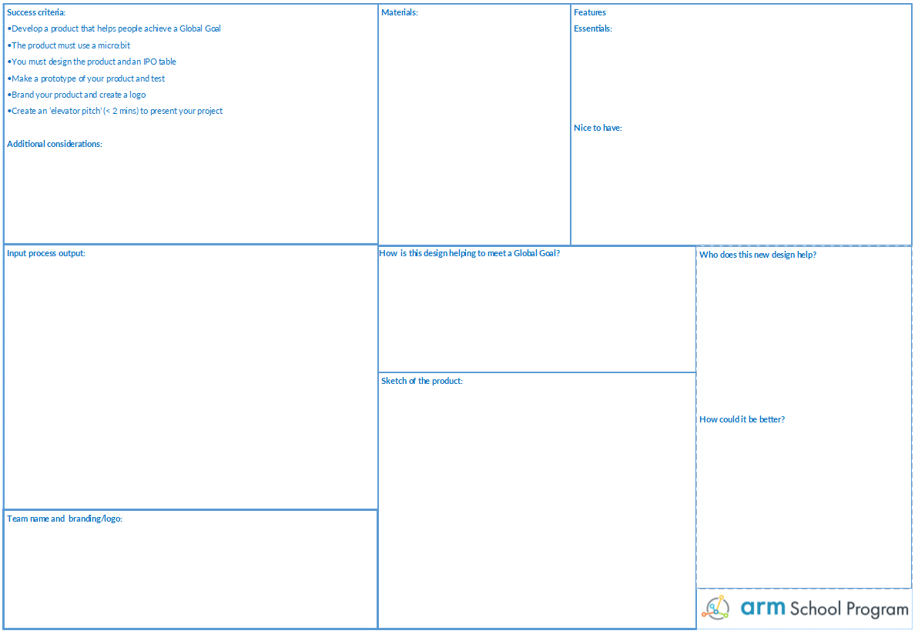
Get designing!
Use the design sheet to capture all your ideas
Think about:
Materials
Features – what is realistic?
IPO
Team name
Logo
How it helps people meet a Global Goal
How could it be improved?
Engineer
Project Manager
Developer
Marketing and communications

Slide 12
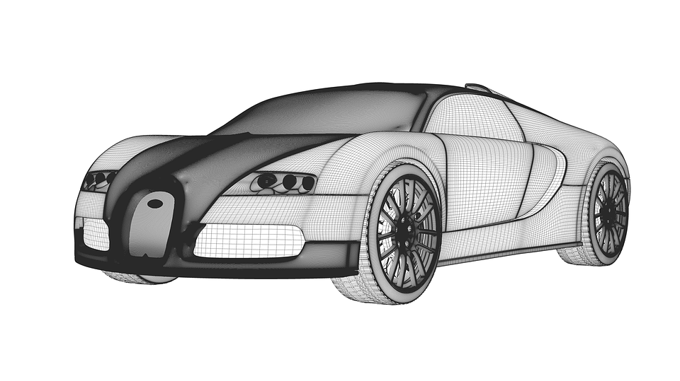
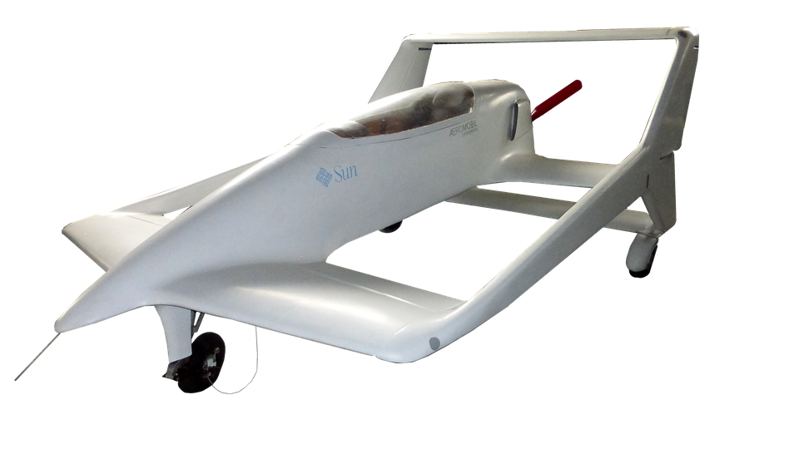
Being realistic
You have 1.5 lessons left
This is just a prototype
The design is just as important as the build
Keep it simple!

Slide 13
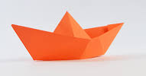
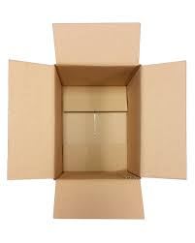
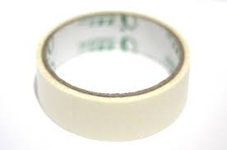
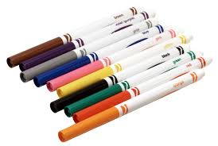
Gathering resources
The engineer will need to gather the materials needed to make the product
Paper
Card
Tape
Glue
String
Pens

Slide 14
Lesson 12
Building

Slide 15
Success criteria
Develop a product that helps people achieve a Global Goal
The product must use a micro:bit
You must design the product and an IPO table
Make a prototype of your product and test
Brand your product and create a logo
Create an ‘elevator pitch’ (< 2 mins) to present your project

Slide 16

Fail early, Fail often
First
Attempt
In
Learning

Slide 17

Branding
Don’t forget to brand the product
You can even use branding in the program!

Slide 18
Elevator pitches
Less than 2 minutes
Can use a presentation
Must describe which global goal the product helps

Slide 19
Evaluation
Complete the evaluation sheet
Reflect on your projects
What went well?
What could you do better?

